Slide 1
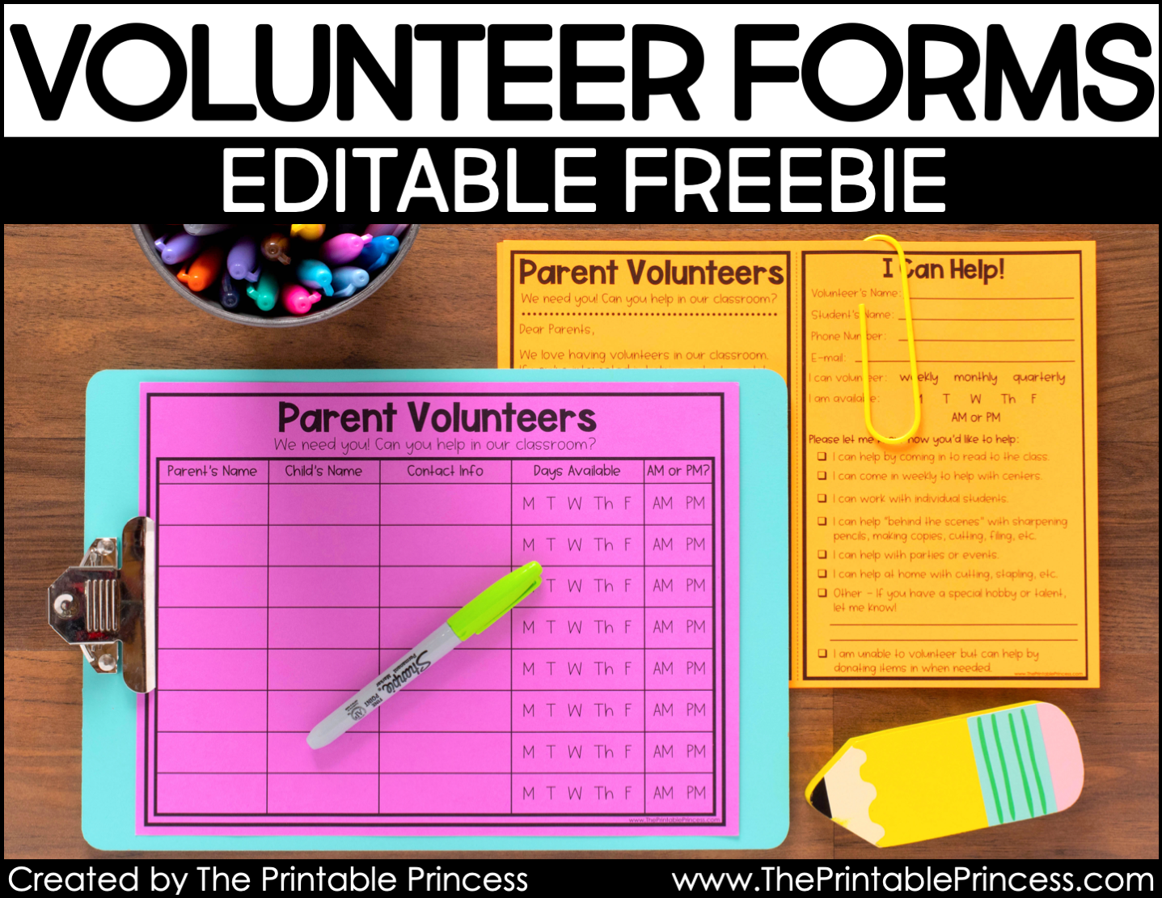

Slide 4
Clipart by Creating4 the Classroom

Slide 5
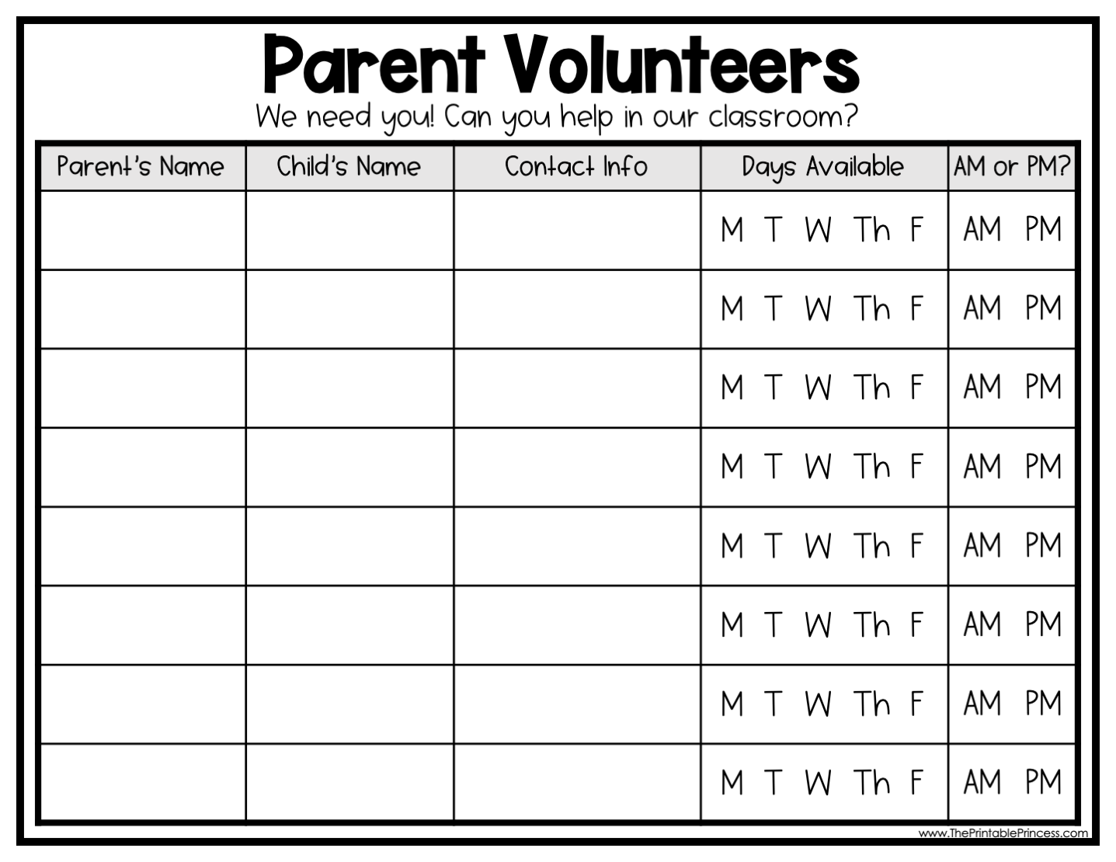

Slide 6
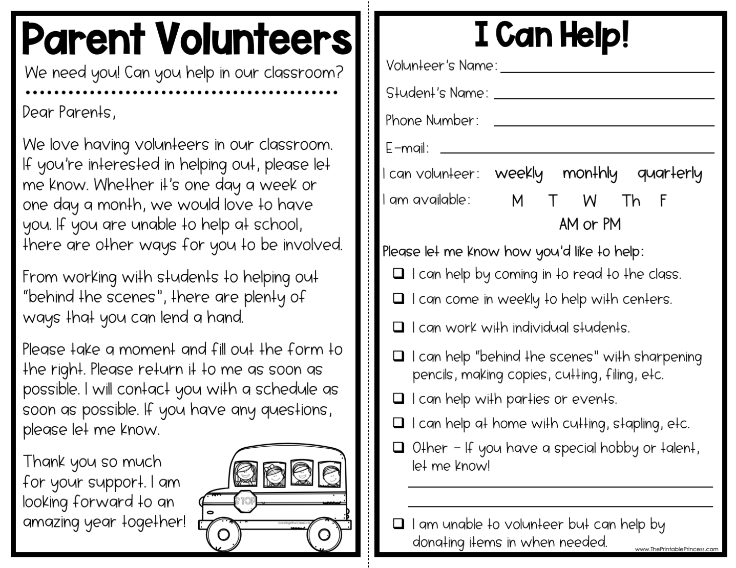

Slide 7
Volunteer’s Name:
Student’s Name:
Dear Parents,
EDITABLE COPY –
TYPE YOUR PARENT LETTER HERE. YOU CAN ALSO EDIT OR DELETE ANY OF THE TEXT BOXES AND LINES ON THE PARENT FORM.
Phone Number:
E-mail:
weekly monthly quarterly
I can volunteer:
M T W Th F
I am available:
AM or PM
Please let me know how you’d like to help:
I can help by coming in to read to the class.
I can come in weekly to help with centers.
I can work with individual students.
I can help “behind the scenes” with sharpening pencils, making copies, cutting, filing, etc.
I can help with parties or events.
I can help at home with cutting, stapling, etc.
Other - If you have a special hobby or talent, let me know!
I am unable to volunteer but can help by donating items in when needed.
Creating4TheClassroom

Slide 8
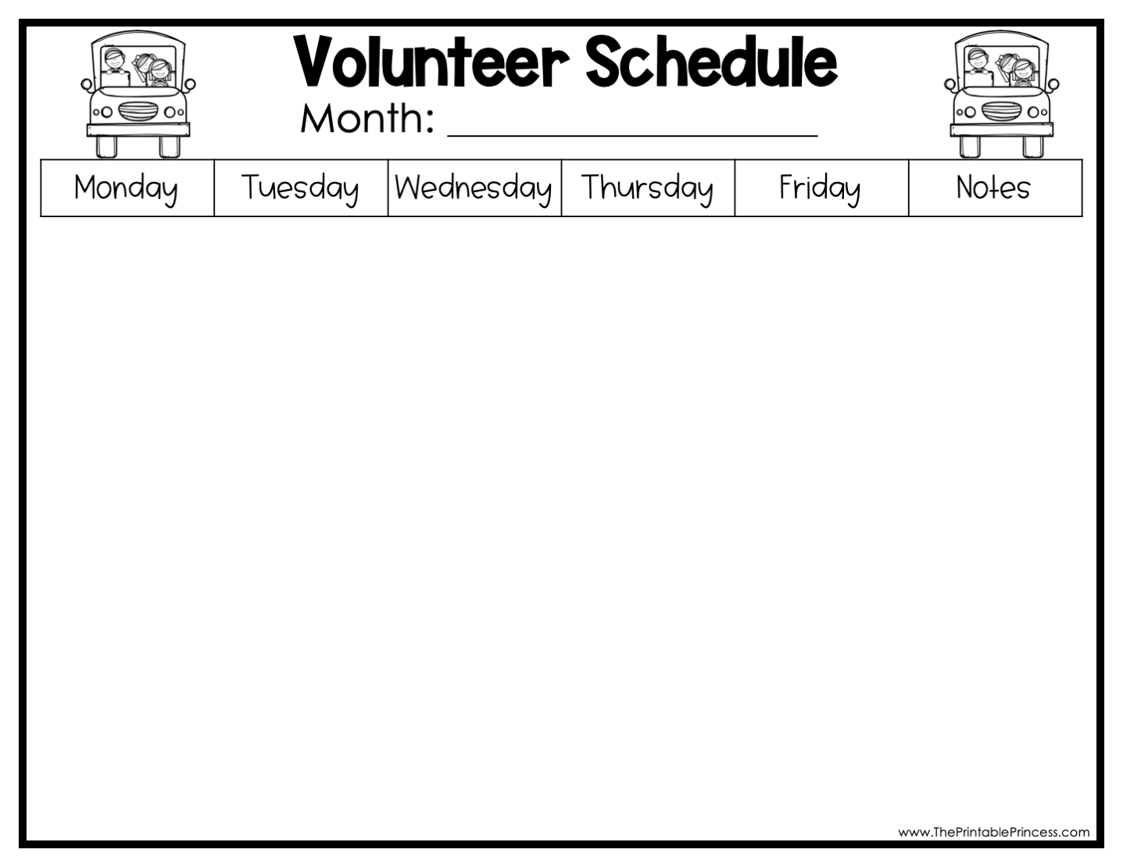
Add the month here
 |  |  | 1 | 2 | Add your notes here, if needed. Or delete text and the column will print empty.
5 | 6 | 7 | 8 | 9
12 | 13 | 14 | 15 | 16
19 | 20 | 21 | 22 | 23
26 | 27 | 28 | 29 | 30
Use textboxes to write in volunteer names.
Or print a blank calendar and write in volunteer names.
Duplicate text boxes to fill in the calendar.

